Slide 1

ENHANCING MEDICAL IMAGE QUALITY USING DEEP LEARNING TECHNIQUES
BY: CHRISTIAN DE LA TORRE, ARACELI CASTELAN, JONATHAN SUCONOTA, KEVIN SOOKRAM
Notes:
Welcome everyone, and thank you for joining our presentation. Today we’ll be discussing our project on enhancing medical image quality using deep learning techniques.

Slide 2
INTRODUCTION
Medical imaging is essential for diagnosis and treatment.
Problem: Many X-ray and fundus images are low-resolution due to aging equipment or poor imaging conditions.
Risks: Low-quality images increase the chance of misdiagnosis and impact patient care.
Our focus: Using deep learning to enhance medical images and evaluating with advanced metrics.
Notes:
Medical imaging is essential in modern healthcare for diagnosis and treatment planning. However, in many clinical settings, especially with older or poorly maintained equipment, images can be low-resolution or noisy.
This can lead to misdiagnosis or missed findings. Our project aims to use deep learning methods to improve the quality of these images, making them more useful for clinicians and ultimately improving patient care.

Slide 3
PROJECT GOALS
Implement and compare deep learning models for super-resolution and image enhancement:
SRCNN (Super-Resolution Convolutional Neural Network)
VDSR (Very Deep Super-Resolution Network)
ClearSight-inspired dehazing (for restoration in challenging conditions)
Evaluate model performance using PSNR (Peak Signal-to-Noise Ratio) and SSIM (Structural Similarity Index).
Notes:
Our main goal was to implement and compare several deep learning models for image enhancement. We worked with SRCNN and VDSR for super-resolution, and a ClearSight-inspired model for dehazing images.
We evaluated the effectiveness of these methods using two established metrics: PSNR, which measures how close the enhanced image is to the original, and SSIM, which assesses perceptual image quality.

Slide 4
LITERATURE REVIEW:
Patil et al. (2024) - Enhancing Medical Image Quality Using Deep Learning Techniques
Compared SRCNN and VDSR for X-ray super-resolution.
SRCNN: Fast, resource-efficient; less detail.
VDSR: Superior detail and clarity; higher computational cost.
Khan et al. (2022) - Integrated Deep Learning Methodology for Early Glaucoma Detection and Diagnosis using Retinal Fundus Images
Developed an integrated deep learning pipeline for early glaucoma detection from retinal fundus images.
Used a custom CNN to automate feature extraction and classification of healthy vs. glaucomatous eyes.
Achieved high accuracy and AUC, highlighting the model’s potential for large-scale, non-invasive glaucoma screening.
Wang et al. (2023) - ClearSight: Deep Learning-Based Image Dehazing for Enhanced UAV Road Patrol
Applied deep CNNs for dehazing UAV images.
Demonstrated that restoration strategies can transfer to medical imaging.
Improved clarity in challenging environments.
Kaderuppan et al. (2024) - Image Comparative Index (ICI): A Pixel-Wise Image Similarity Metric for Computational Super-Resolution (SR) Microscopy
Proposed the Image Comparative Index (ICI) metric.
ICI provides better alignment with human perception compared to PSNR and SSIM.
Especially valuable for assessing super-resolved images.
Notes:
We reviewed several recent papers to ground our approach.
Patil et al. compared SRCNN and VDSR, highlighting the tradeoff between computational efficiency and detail.
Khan et al. developed a deep learning pipeline for glaucoma detection, showing high accuracy and the promise of AI in screening.
Wang et al. introduced ClearSight, showing how dehazing techniques can restore clarity even in challenging environments, with lessons applicable to medical imaging.
Kaderuppan proposed a new image metric called ICI, but for our project we focused on more established metrics.

Slide 5
LITERATURE REVIEW:
Bellal et al. (2022) - A Comprehensive Survey on Deep Learning in Abdominal Imaging: Datasets, Techniques, and Performance Metrics
Surveyed deep learning in abdominal imaging.
Reviewed enhancement models and a wide range of evaluation metrics.
Emphasized importance of both technical and clinical validation.
Yuan et al. (2021) - Manifold and patch-based unsupervised deep metric learning for fine-grained image retrieval
Developed unsupervised, patch-based metric learning for fine-grained image retrieval.
Patch-level approaches help distinguish subtle features.
Inspired our data augmentation and sampling strategies.
Notes:
Bellal et al. surveyed deep learning applications in abdominal imaging and emphasized the importance of both technical performance and clinical validation.
Yuan et al. introduced a patch-based metric learning method that improves the retrieval of fine-grained image details, which influenced our data augmentation and sampling strategies.

Slide 6
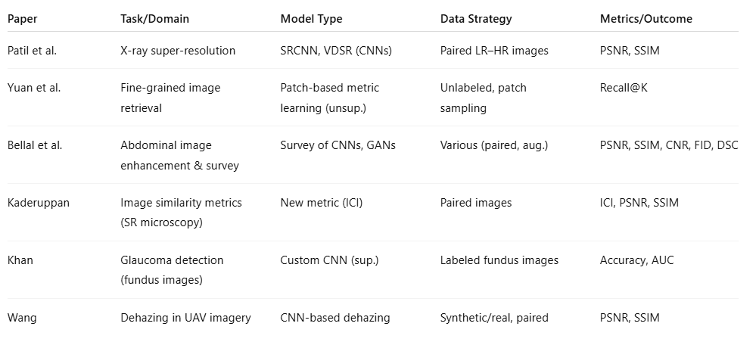
COMPARISON OF APPROACHES:
Notes:
We compared approaches across the literature, noting that models like VDSR provide high detail but at a higher computational cost.
Other works explored unsupervised and patch-based methods to address specific challenges, like data scarcity or subtle feature recognition.
This comparison helped us choose the right techniques for our own project.

Slide 7
OUR METHODOLOGY
PSNR (Peak Signal-to-Noise Ratio): Measures how closely the enhanced image matches the original.
PSNR quantifies the similarity between the enhanced and original image, using the mean squared error.
Expressed in decibels (dB)
Higher PSNR = better fidelity.
Ensures enhanced images remain true to the original, which is important for accurate medical interpretation.
Used alongside SSIM to assess both pixel accuracy and perceptual quality.
SSIM (Structural Similarity Index): Assesses perceived image quality by evaluating structural similarity.
SSIM plays an important part in this attempt in determining how effectively the models captured the structural characteristics of the medical images.
High SSIM values indicate models capability to preserve important characteristics necessary for accurate diagnosis, such as tissue borders and diseased structures.
We considered both measures as they complement each other.
Notes:
PSNR: Good for general fidelity - In our work, PSNR helps ensure that our models are producing images that remain true to the original—a critical consideration for medical diagnosis.
SSIM: Good for preserving diagnostic details - High SSIM values mean that the image remains diagnostically useful.
Both: Give a fuller picture of image quality and clinical usefulness - We used both PSNR and SSIM because together they provide a fuller picture of image quality.

Slide 8
DATASETS
NIH Chest X-ray Dataset: Over 100,000 frontal-view X-rays.
https://www.kaggle.com/datasets/nih-chest-xrays/sample
This NIH Chest X-ray Dataset is comprised of 112,120 X-ray images with disease labels from 30,805 unique patients.
Chest X-Ray Images (Pneumonia) Over 5,000 X-rays.
https://www.kaggle.com/datasets/paultimothymooney/chest-xray-pneumonia
The dataset is organized into 3 folders (train, test, val) and contains subfolders for each image category (Pneumonia/Normal). There are 5,863 X-Ray images (JPEG) and 2 categories (Pneumonia/Normal).
CoronaHack - Chest X-Ray-Dataset: Over 5,000 X-rays.
https://www.kaggle.com/datasets/praveengovi/coronahack-chest-xraydataset
Collection of 5800 + Chest - X Ray Healthy vs Pneumonia (Corona) affected patients infected patients along with few other categories such as SARS (Severe Acute Respiratory Syndrome ) ,Streptococcus & ARDS (Acute Respiratory Distress Syndrome)
Notes:
These datasets allowed us to test our models on a variety of scenarios.

Slide 9
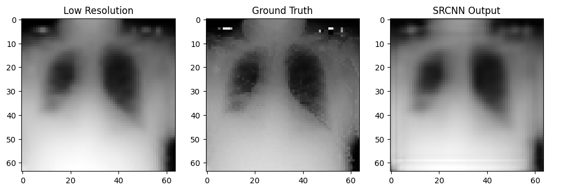
PRELIMINARY RESULTS: NIH Chest X-rays data set
Before:
After:
Notes:
On the left, you can see the original low-resolution or degraded images
On the right, the outputs from our enhancement models.
Across datasets and conditions, our deep learning models were able to restore significant detail, as confirmed by higher PSNR and SSIM scores.

Slide 10
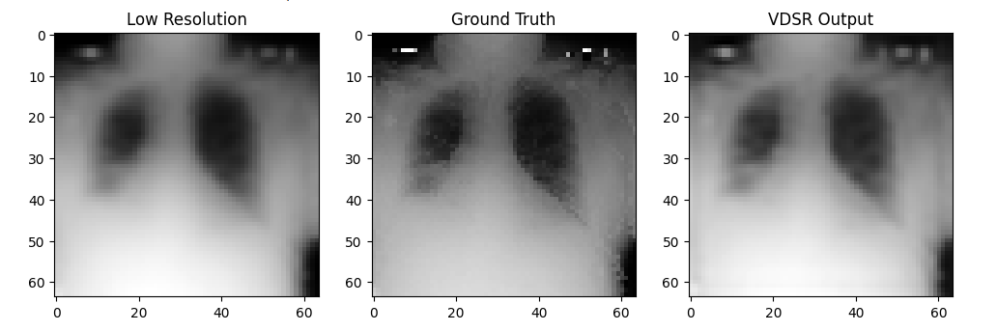
PRELIMINARY RESULTS
Before:
After:

Slide 11
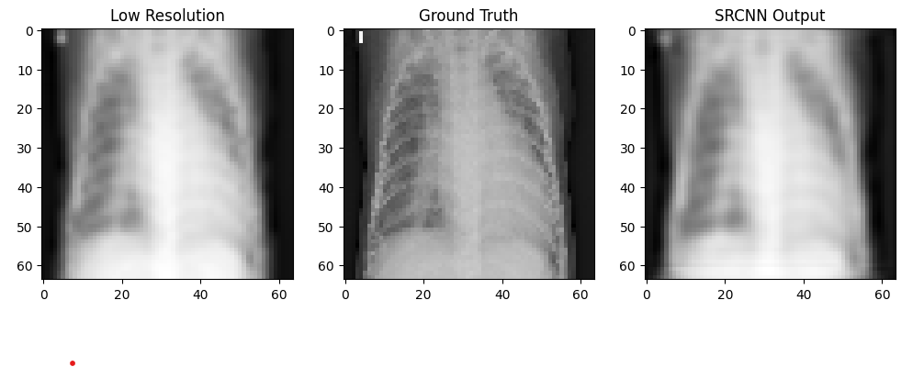
PRELIMINARY RESULTS: CoronaHack -Chest X-Ray-Dataset
Before:
After:

Slide 12
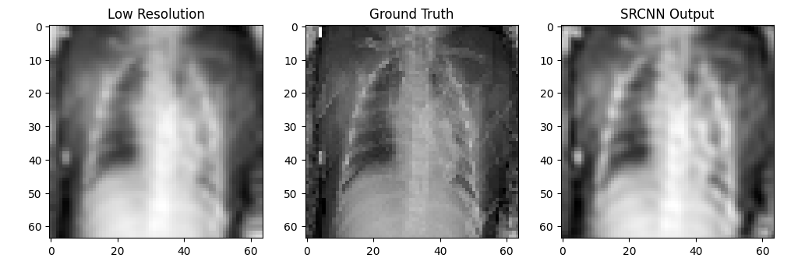
PRELIMINARY RESULTS: Chest X-Ray Images (Pneumonia)
Before:
After:

Slide 13
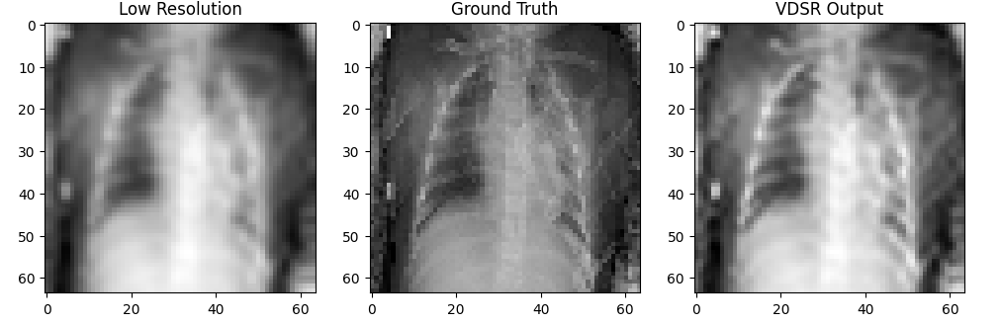
PRELIMINARY RESULTS
Before:
After:

Slide 14
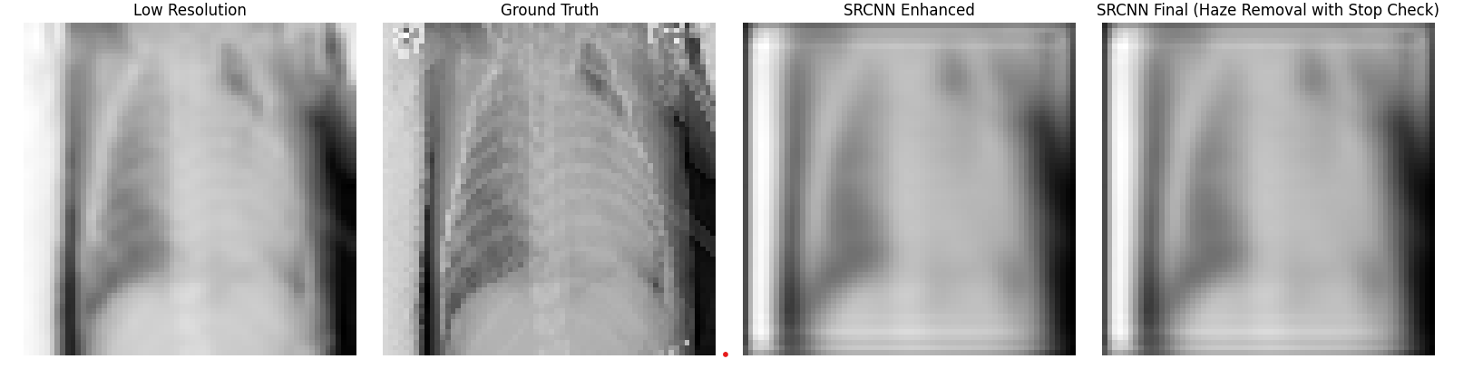
PRELIMINARY RESULTS CORONAHACK data set + haze remover algorithm
Before:
After:
Notes:
After testing haze for a bit we notice that it would deteriorate the images so we added a threshold to halt if the images became significantly worst that the enhanced images.
Example in the last slide.

Slide 15
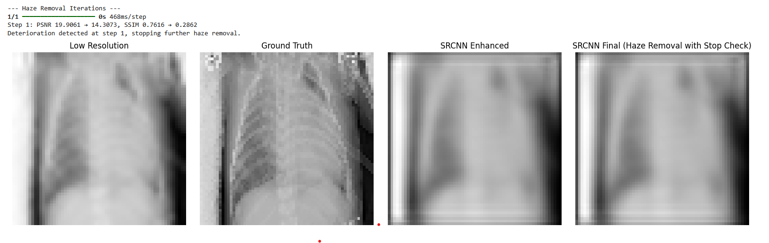
PRELIMINARY RESULTS
Before:
After:

Slide 16
PRELIMINARY RESULTS
Before:
After:

Slide 17
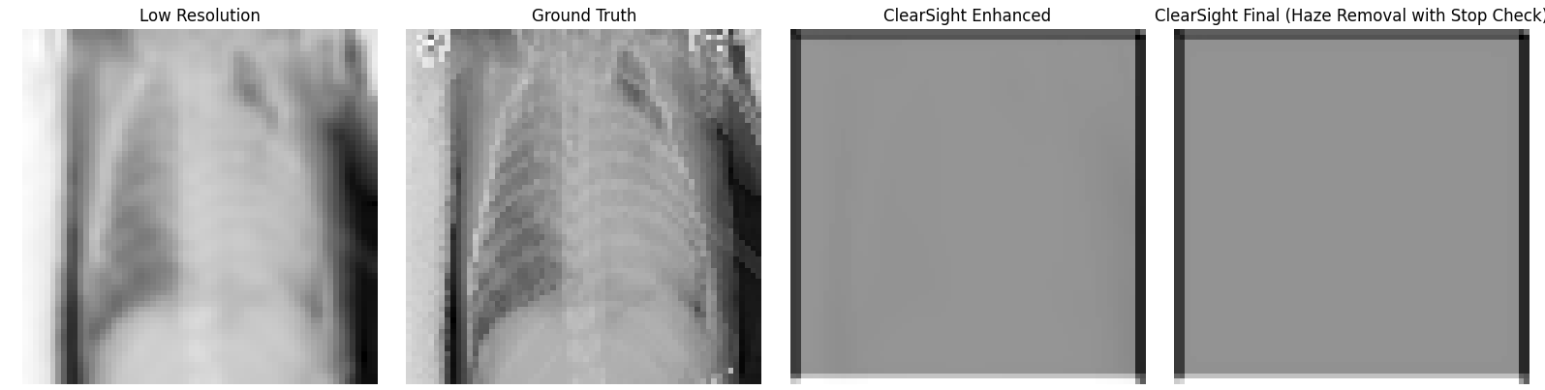
PRELIMINARY RESULTS: If halting isn’t applied
Before:
After:

Slide 18
GAPS AND OPEN QUESTIONS
Clinical Relevance of Metrics:
While PSNR and SSIM measure image similarity, it remains unclear how well these metrics correlate with diagnostic accuracy and real clinical utility.
Generalization:
Will the trained models perform equally well on images from different hospitals, imaging devices, or patient populations?
Dataset Limitations:
Small sample sizes and reliance on publicly available datasets may not fully capture real-world variability.
Automation and Interpretability:
Can the enhanced images and deep learning models provide explanations that clinicians trust for high-stakes decisions?
Real-Time Performance:
How can we further optimize models for speed and efficiency in clinical workflows, especially in resource-limited settings?
Future Metrics:
What alternative or perceptual image quality metrics might better capture what matters for clinical diagnosis?
Notes:
Despite our progress, several open questions remain.
First, do improvements in PSNR and SSIM actually translate to better diagnostic decisions by clinicians?
Will our models perform just as well on data from other hospitals or imaging devices?
Are our current datasets large and diverse enough to capture real-world variability?
And finally, how can we make our models both interpretable and fast enough for real-time use in clinical settings?
These are areas for future research.

Slide 19
CONCLUSION AND NEXT STEPS
Deep learning techniques—specifically SRCNN, VDSR, and ClearSight-inspired models—can significantly enhance the quality of low-resolution medical images.
Evaluation with PSNR and SSIM shows that deeper architectures like VDSR restore more structural detail, while SRCNN remains valuable for resource-limited settings.
Our results suggest that deep learning-based image enhancement can improve diagnostic accuracy and patient care, especially where high-quality imaging equipment is lacking.
Further work is needed to validate these models on more diverse datasets and new imaging devices, and to explore metrics that better reflect clinical needs.
Integrating enhanced images into clinical workflows may help bridge the gap between technological advances and real-world healthcare outcomes.
Notes:
To conclude, we’ve shown that deep learning methods like SRCNN, VDSR, and ClearSight-inspired models can substantially enhance low-quality medical images.
VDSR produced the most visually and quantitatively improved results, but all models showed some benefit.
Going forward, we aim to validate these models on more diverse datasets and new devices, and to collaborate with clinicians to assess their real-world impact.
Integrating these enhancements into everyday clinical practice could lead to more accurate diagnoses and better patient outcomes.

Slide 20

THANK YOU
Notes:
Thank you for your attention! We’d be happy to answer any questions

